Slide 1

Shaders in Godot Pt 2

Slide 2
Why Godot?
Open Source
Easily Modifiable
Easy to Learn and Use
Consistently Updated
Lots of Community Support
Large Library of Open Source Code and Assets

Slide 3
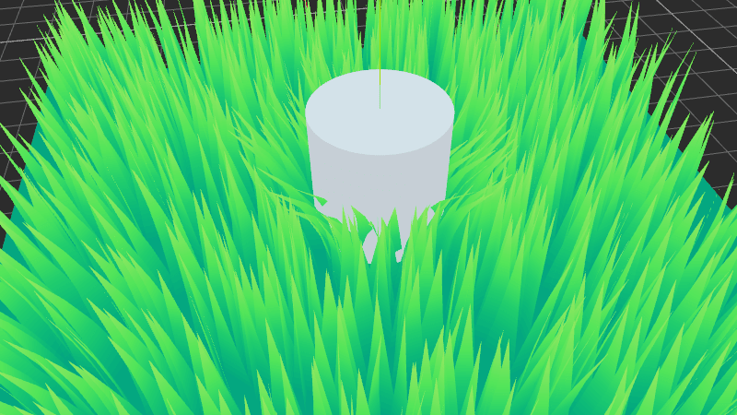
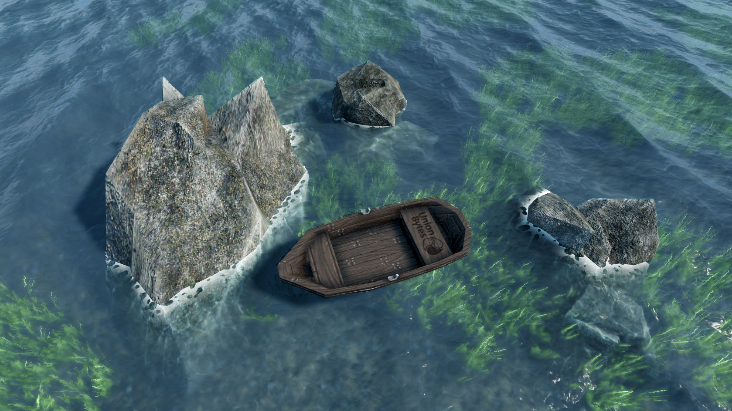
Vertex Shaders
- godotshaders.com
- godotshaders.com

Slide 4
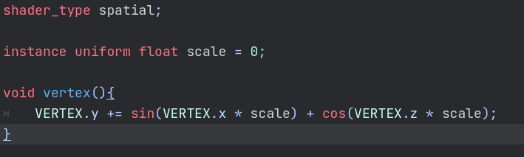
What They Are
Used to reshape a mesh
Runs on every point on a mesh at once
Executed on GPU

Slide 5
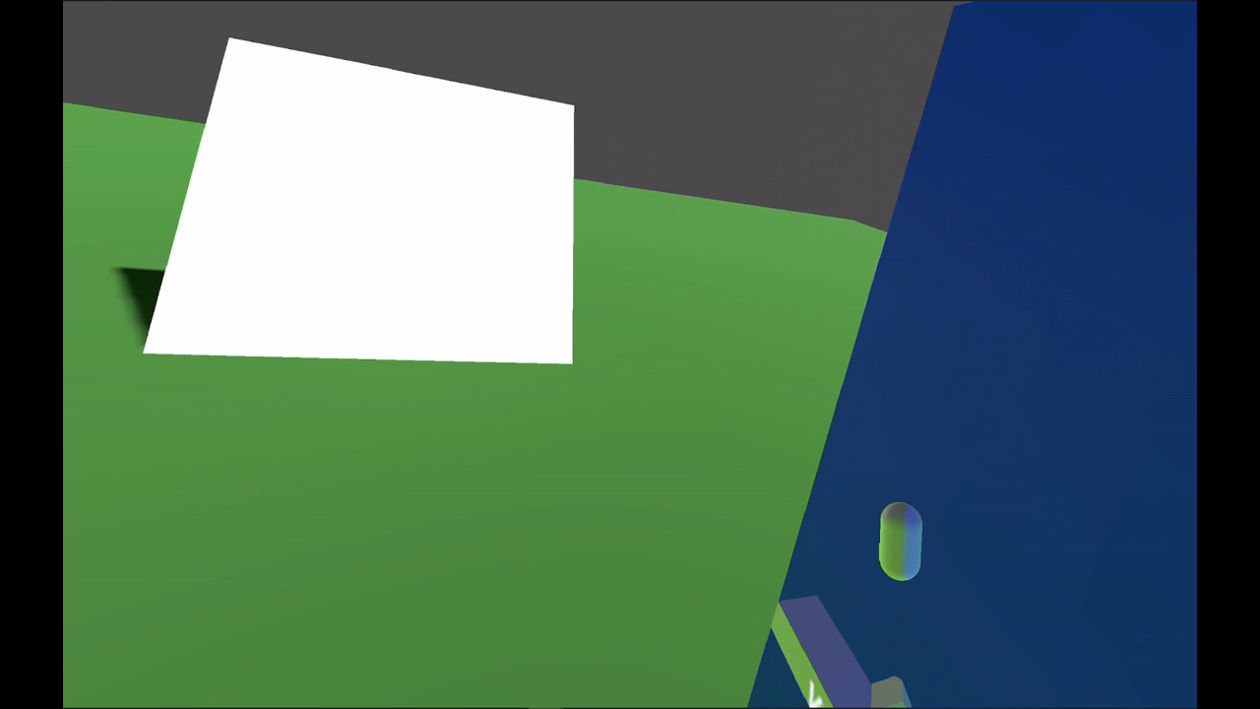

Slide 6
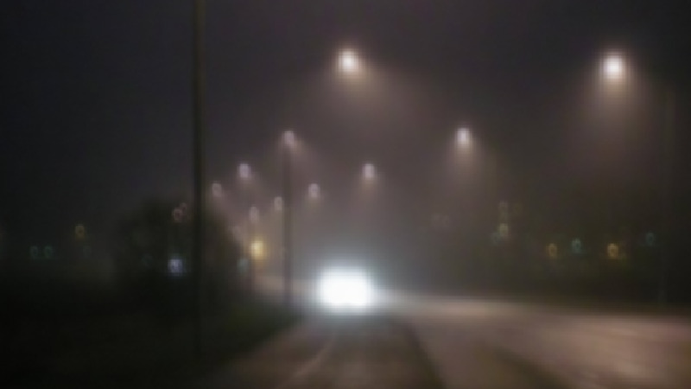
Shaders for Post Processing
- godotshaders.com

Slide 7
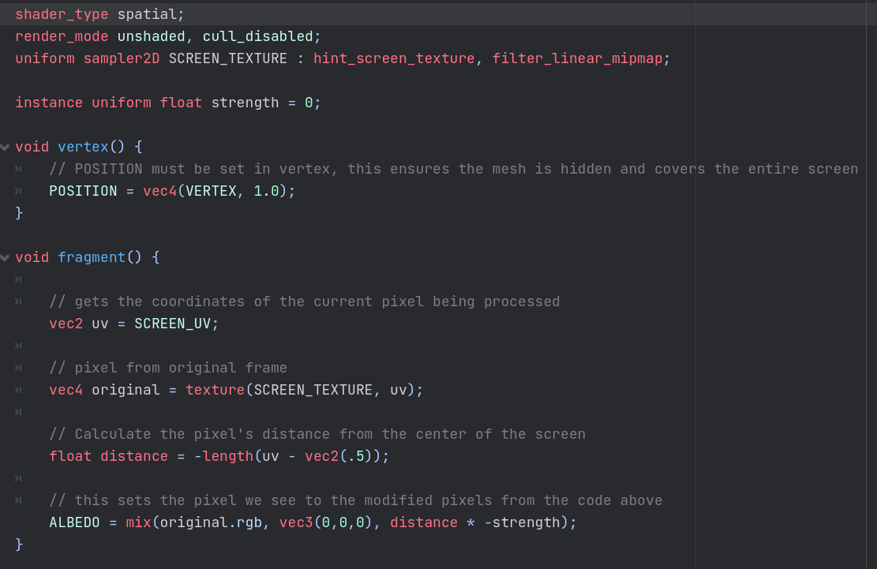
Shaders for Post Processing
pt 2
Very useful for a lot of different effects
A bit more complicated to set up and code

Slide 8
